Slide 1
Periodic Table Terms and Concepts

Slide 2
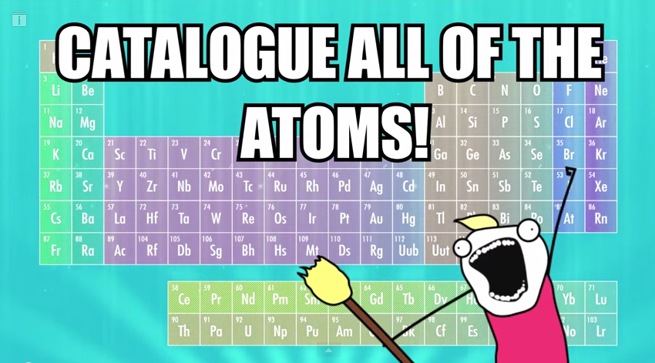
History and Overview

Slide 3
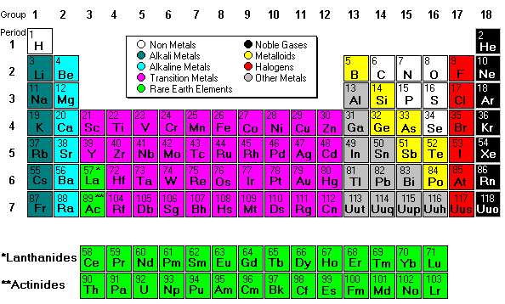

Slide 4
Metals
Atoms of metals readily lose their outer shell electrons, resulting in a free flowing (delocalized) cloud of electrons within their otherwise solid arrangement.
This provides the ability of metallic substances to easily transmit heat and electricity.
Properties of Metals
Video – Steel: From Start to Finish
Video – How Aluminum Foil is Made

Slide 5
The solidity of the metal is produced by electrostatic interactions between the nucleus and the electron cloud. This type of bond is called a metallic bond. Explain why Mg has a higher melting point than Na.

Slide 6
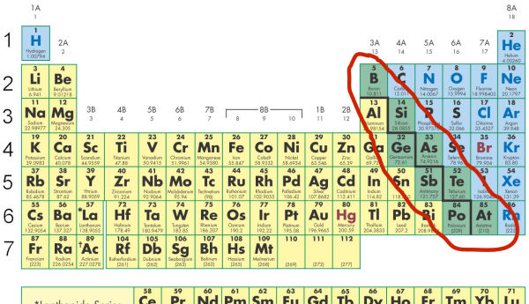
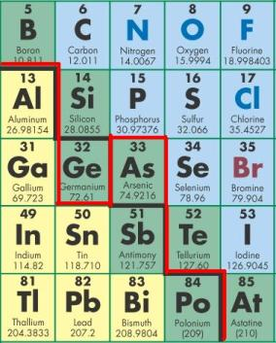
Metalloids

Slide 7
Nonmetals

Slide 8
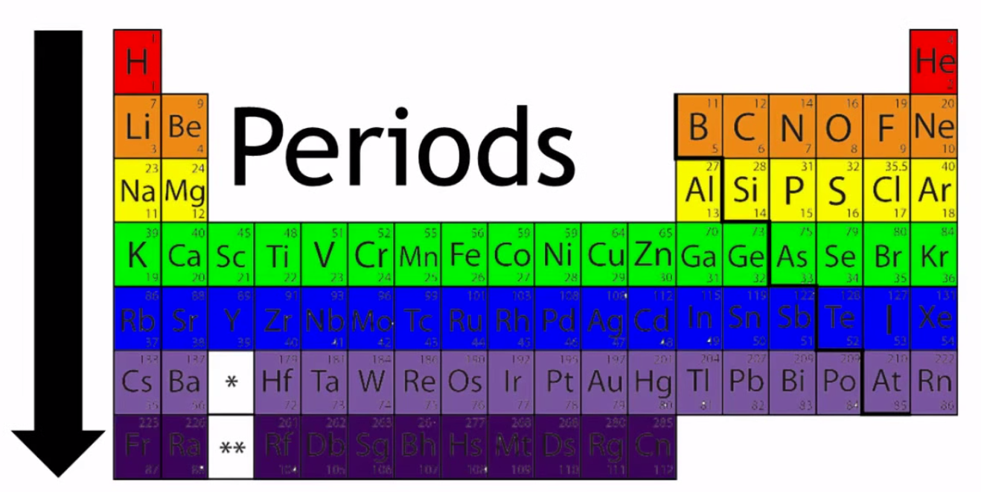
Period
Elements in the same period have the same number of electron shells; across a period each element gains one more proton/electron and becomes less metallic.

Slide 9
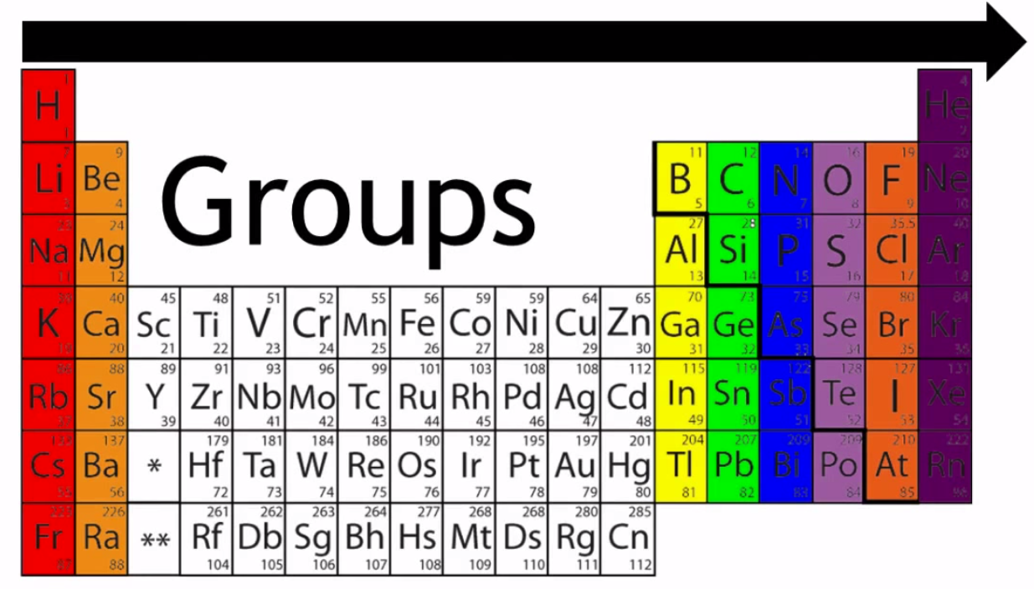
Groups
The elements in each group have the same number of electrons in the outer shell. Those outer electrons are also called valence electrons. They are the electrons involved in chemical bonding with other elements. This arrangement reflects the periodic recurrence of similar properties as the atomic number increases.

Slide 11
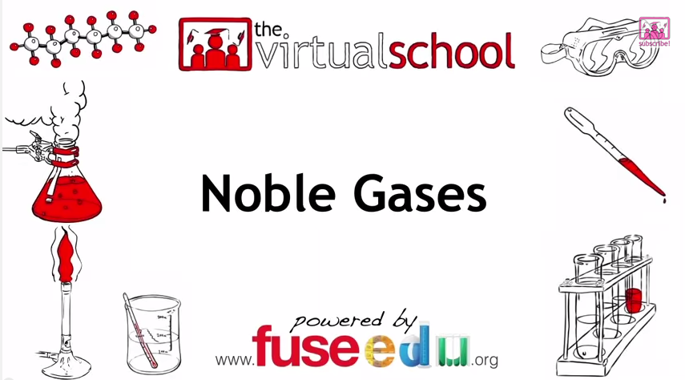

Slide 12
Periodic Trends
Physical and chemical properties of elements vary across a period and down a group in a predictable manner.

Slide 13
Trends in Atomic Radius

Slide 14
Trends in Electronegativity

Slide 15
Trends in Ionization Energy

