Slide 1
Acids, pH, and Buffers: Some Basic Chemistry for Biological Science
Terry Platt
University of Rochester

Slide 2
Paul Mathews has just learned about acidity in his chemistry class, and…
surprises his parents with questions about the acidity of common substances, such as:
Coffee pH 5!
Vinegar pH 3!
Can you guess the pH of tomatoes? Cola or beer? Lemon juice? Your stomach?
But what is an acid, and what is pH?

Slide 3
What is an Acid?
An acid is a substance which, when dissolved in water, releases protons.
The extent of dissociation, that is, the amount of protons released compared to the total amount of compound, is a measure of the strength of the acid.
For example, HCl (hydrochloric acid) is a strong acid, because it dissociates completely in water, generating free [H⁺] and [Cl⁻].
Acidity can be measured on a scale called pH (more scarily, “the negative logarithm of the hydrogen ion concentration”).

Slide 4
CQ#1: An acid is a compound that in aqueous solution will readily:
Shed a proton.
Shed an electron.
Gain a proton.
Gain an electron.
None of the above.

Slide 5
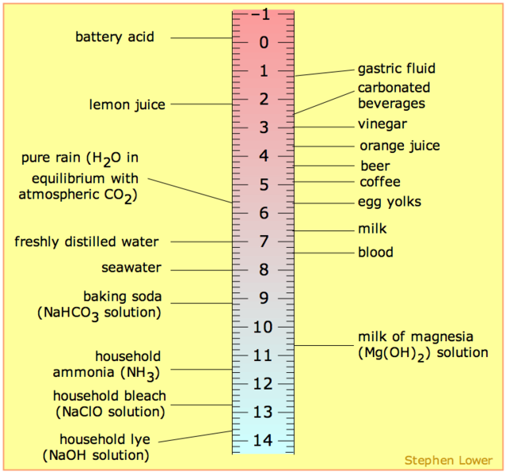
SOURCE: http://en.wikipedia.org/wiki/Image:PH_scale.png#file
pH
[H⁺] M
10⁰
^{A strong acid}
Most living cells have a very narrow range of tolerance for pH, i.e. [H⁺].
The [H⁺] concentration will be important (either explicitly or implicitly) for many other topics in biology.
[H⁺] is controlled in all biological organisms, and in virtually all biochemical experiments.
Each pH unit represents a factor of 10 difference in [H⁺].
10⁻¹
10⁻²
10⁻³
10⁻⁴
10⁻⁵
10⁻⁶
10⁻⁷
10⁻⁸
10⁻⁹
10⁻¹⁰
10⁻¹¹
10⁻¹²
10⁻¹³
^{A strong base}
10⁻¹⁴
The pH scale goes from 0 to 14—because [H⁺][OH⁻] = 10⁻¹⁴

Slide 6
CQ#2: In an aqueous solution where the H⁺ concentration is 1 x 10⁻⁶ M, the OH⁻ concentration must be:
A. 14 x 10⁻⁶ M
B. 1 x 10⁻⁶ M
C. 1 x 10⁻⁷ M
1 x 10⁻⁸ M
14 x 10⁻⁸ M

Slide 7
The Conceptual Problem with pH
Because it’s a logarithmic scale, it doesn’t make “sense” to our brains.
But Paul explains it well—every factor of 10 difference in [H⁺] represents 1.0 pH units, and
Every factor of 2 difference in [H⁺] represents 0.3 pH units.
Therefore, even numerically small differences in pH, can have profound biological effects…

Slide 8
How Can You Actually Determine the pH of a Solution?
Use a pH meter—read the number.
Use pH paper (color patterns indicate pH).
Titrate the solution with precise amounts of base or acid in conjunction with a soluble dye, like phenolphthalein, whose color changes when a specific pH is reached.
8

Slide 9
In our story, the mother had to run home really hard—let’s look at some of the effects:
Is there a volunteer to help out?
Instructions: blow gently through the straw into the pink solution for 15-30 seconds.
What happens?
What does the “indicator” tell you?
Why did it happen?

Slide 10
RESULTS
The solution went from pink to clear,
indicating a decrease in pH (the color- changing dye is phenolphthalein),
i.e., an increase of acidity.
What could this be due to?

Slide 11
The Hydration of Carbon Dioxide in Water
CO₂ + H₂O
H₂CO₃
⇌ HCO₃⁻ + H⁺
As carbon dioxide goes into solution, carbonic acid is formed, which partially dissociates, liberating protons (H⁺) and thus causing the solution to become more acidic, i.e., lowering the pH.

Slide 12
And you can apply what you just learned about carbon dioxide…
When Molly’s mom ran home so hard, what do you think would have happened to the pH (acidity) of her blood?
What would be the effect on pH once she stops running, but continues to breathe hard for a few minutes? Why?
For an athlete about to begin an event, what would the consequence of hyperventilation be on her blood pH? What advantage might this confer?
So, in water, CO₂ forms a weak acid!

Slide 13
But What’s a Weak Acid?
Some substances, like acetic acid (vinegar!) dissociate poorly in water.
Thus, they release protons, but only a small fraction of their molecules dissociate (ionize).
Such compounds are considered to be weak acids.
Thus, while 1 M HCl is pH = 0 (why?), 1 M acetic acid is only pH = 2.4…

Slide 14
Weak acids thus are in equilibrium with their ionized species:
Governed by the Law of Mass Action, and characterized by an equilibrium constant:
HA H⁺ + A⁻
K_{eq} =
[H⁺][A⁻]
[HA]

Slide 15
Water: A Very Weak Acid
+ +
hydronium ion hydroxide ion
2 H₂O H₃O⁺ + OH⁻
(an acid) (a base)
But this hardly happens at all: In fact, at equilibrium,
[H⁺] = [OH⁻] = 0.0000001 M = 10⁻⁷ M = pH 7
Indeed, only two of every 10⁹ (1 billion) molecules in pure water are ionized at any instant - Can you confirm this?

Slide 16
Comparative Equilibrium Constants
Water: K_{eq} = 1.8 x 10⁻¹⁶
Acetic acid K_{eq} = 1.7 x 10⁻⁵
A 100 billion-fold difference…
But still, of every 1000 acetic acid molecules in a 1 M solution of acetic acid, only 4 are ionized.
Can you figure out how to figure that out?

Slide 17
For biological systems:
Ionization of a strong acid is TOO BIG!
Ionization of water itself is way TOO LITTLE!
Ionization of a weak acid is JUST RIGHT!

Slide 18
But Molly’s problem is with a weak acid…
She has ingested far too much aspirin, i.e., acetylsalicylic acid, which has brought her to the Emergency Room.
The window of pH within which humans can survive is between a blood value of about pH 6.8 to around pH 8.0.
Outside that range brings coma and death.
Thus rapid treatment for Molly is crucial.

Slide 19
CQ#3: By what factor does the [H⁺] of Molly’s blood (pH 6.8) differ from normal (pH 7.4)?
0.25x
0.5x
0.6x
2.0x
4.0x

Slide 20
What if you could reverse this… by removing carbon dioxide?
CO₂ + H₂O
H₂CO₃
HCO₃⁻ + H⁺
As carbon dioxide leaves the solution, carbonic acid is used up, which by the Law of Mass Action shifts the equilibrium to the left, using up protons (H⁺) and thus causing the solution to become less acidic, i.e., raising the pH.

Slide 21
CQ#4: Why is Molly breathing so rapidly and deeply when she arrives at the Emergency Room, despite being nearly comatose?
The aspirin has inhibited her ability to use oxygen effectively.
Her body is trying to rid itself of CO₂.
She is out of breath from all she has been through.
Her hemoglobin can’t deliver oxygen at low pH.

Slide 22
Unfortunately, Molly’s breathing isn’t helping very much—can you guess why that is?
Think about the aspirin in her bloodstream and the equilibrium between its acid (undissociated) and its dissociated form.
As protons are removed from solution by her heavy breathing, is there a reservoir of others to take their place…?
Try to discuss and explain this to a person sitting near you.

Slide 23
CQ#5: How else might you raise the pH of Molly’s blood to get it back into the normal range?
Add HCl
Add acetylsalicylic acid
Add phosphate
Add bicarbonate
Add NaOH

Slide 24
Why should bicarbonate help?
As just seen, bicarbonate is one of the ionization products of carbonic acid—what is the other one?
By the Law of Mass Action, the addition of a lot of bicarbonate should drive the reaction—in which direction?
Think about this: if you add baking soda to vinegar, what will happen, and what does it mean?

Slide 25
How Does This Work?
CO₂ + H₂O
H₂CO₃
⇌ HCO₃⁻ + H⁺
Here, the addition of excess bicarbonate will soak up many of the free protons, and drive the equilibrium to the left. This will reduce the acidity, increasing the pH, and the carbon dioxide produced will be blown off in the lungs. And make Molly feel MUCH better!

Slide 26
How can this help Molly?
This will reduce the acidity, which means
increasing the pH, and …
the carbon dioxide produced will be blown off in the lungs.
This will make Molly feel much better.
And get her out of medical danger…

Slide 27
Weak acids, their conjugate bases, and buffers…
Weak acids have only a modest tendency to shed their protons (definition of an acid).
When they do, the corresponding negatively charged anion becomes a willing proton acceptor, and is called the conjugate base.
The properties of a buffer rely on a balance between a weak acid and its conjugate base.
And a titration curve looks like this…

Slide 28
pK_{a} = 4.76
Titration of acetic acid with sodium hydroxide
pH 7
_
_
_
_
_
_
_
Buffering range: only small pH changes result from addition of base or acid
50% dissociation
0 equiv. of NaOH 1.0
added

Slide 29
How did this save Molly’s life?
A buffer is a solution of a weak acid and its conjugate base that resists changes in pH in both directions—either up or down.
A buffer works best in the middle of its range, where the amount of undissociated acid is about equal to the amount of the conjugate base.
One can soak up excess protons (acid), the other can soak up excess hydroxide (base).

Slide 30
Ionization of acetic acid: Resisting changes both ways
OH⁻ H₂O
Acetic acid HAc Ac⁻ Acetate
(CH₃COOH) (CH₃COO⁻)
H⁺

Slide 31
Insights for the Future
pH control is important, as many enzymes have a narrow range in which they function optimally.
Buffering capability is essential for the well-being of organisms, to protect them from unwelcome changes in pH.
For example, your stomach is about pH 1, yet the adjacent portion of your intestine is near pH 7—think about (or look up) how that might happen [Hint: what is one function of the pancreas?].
Many compounds and macromolecules in addition to bicarbonate can serve a buffering function—proteins comprise one of the major classes.

