Slide 1
Determining the Molar Mass of Butane Using the Ideal Gas Law

Slide 2
What is an Ideal Gas?
An ideal gas obeys the Ideal Gas Law: PV = nRT where
P = pressure (kPa, kilopascals) V = volume (L, liters) n = moles of gas T = temperature (K, Kelvin) R = gas constant = 8.314 L kPa K⁻¹ mol⁻¹

Slide 3
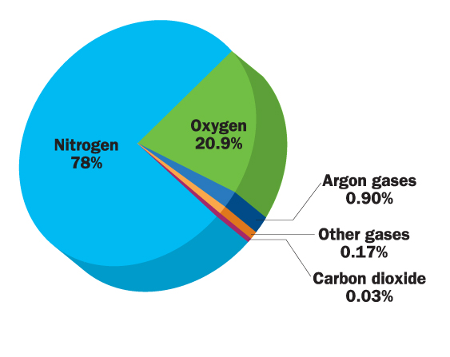

Slide 4
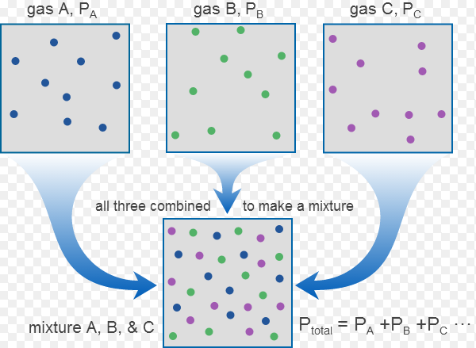
Partial Pressure of Gases

Slide 5
Dalton’s Law of Partial Pressures PT = P1 + P2 + P3 + … The total pressure in a mixture of gases is the sum of the partial pressures of each gas
For dry air:
Patm = PN2 + PO2 + PAr + Pother
1atm = 0.78 + 0.209 + 0.009 + 0.002
101.3 kpa = 79.0 + 21.2 + .9 + .2

Slide 6
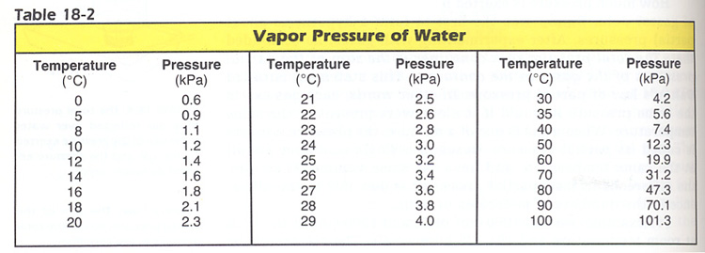
What about Vapor Pressure of Water (PH2O)?
Yes, the vapor coming off a liquid has a partial pressure too. This increases with temperature.

Slide 7
Experimental Approach
1. Measure mass of butane (g)
2. Determine moles of butane
3. Calculate molar mass (g/mol)

Slide 8
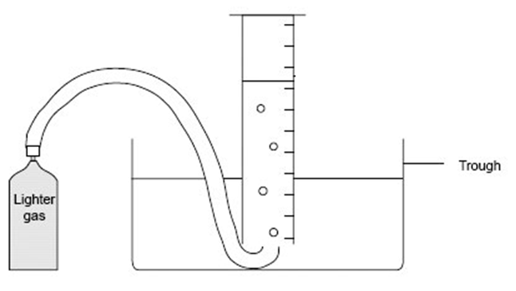
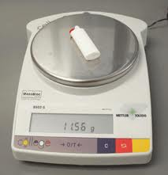
Measure Mass of Butane
Mass of lighter before releasing gas
Mass of lighter after releasing gas

Slide 9
Determine Moles of Butane
Part A. Measure the volume of butane collected in the graduated cylinder = V

Slide 10
Determine Moles of Butane
Part B. Calculate the partial pressure of butane (P)
Subtract the partial pressure of water from atmospheric pressure (in kPa)

Slide 11
Determine Moles of Butane
Part C. Calculate moles butane using the Ideal Gas Law
PV = nRT is rearranged to solve for n:
n = PV/RT
Plug in values for P, V, R, and T (R is the gas constant 8.314 J K⁻¹ mol⁻¹

Slide 12
Calculate Molar Mass of Butane
Molar Mass = mass/mole (g/mol)
Therefore, divide mass (g)of butane by n (moles)
Also, calculate the molar mass of butane from its chemical formula (C4H10) and compare with your experimental value.

