Slide 1
Chemistry Laboratory Safety Rules

Slide 2
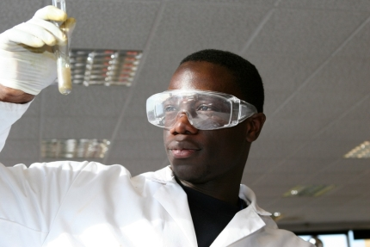
Protect Your Eyes
Appropriate eye protection must be worn at all times! Eyeglasses are not enough!

Slide 3
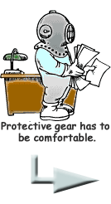
Wear appropriate protective clothing
Lab aprons can be used to protect your clothing
Loose clothing should not be worn because it may dip into chemicals or fall into a flame and catch fire

Slide 4
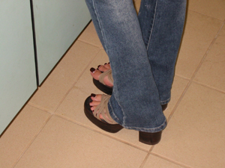
Wear shoes that cover your feet.
Sandals and open-toed shoes do not protect your feet from broken glass that is frequently found in the lab

Slide 5
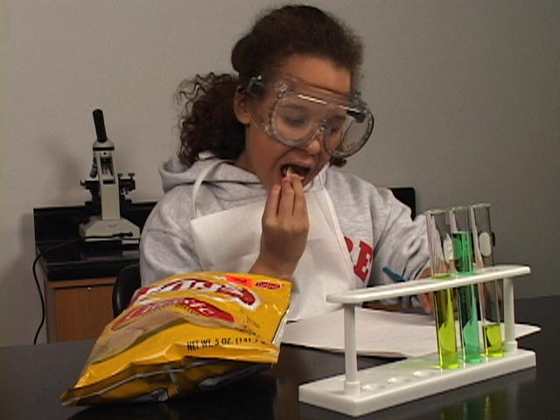
Do not apply cosmetics, eat, or drink in the lab.
These activities are ways by which you can accidentally ingest harmful chemicals

Slide 6
Do not taste any chemical!

Slide 7
No backpacks or purses on the lab bench!

Slide 8
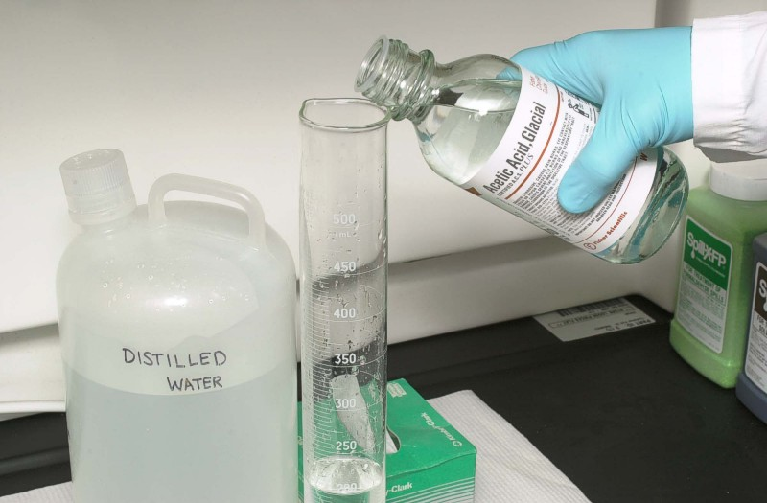
Always ADD ACID to water
What happens if water to acid?

Slide 9
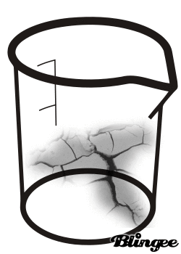
Check glassware for cracks.

Slide 10
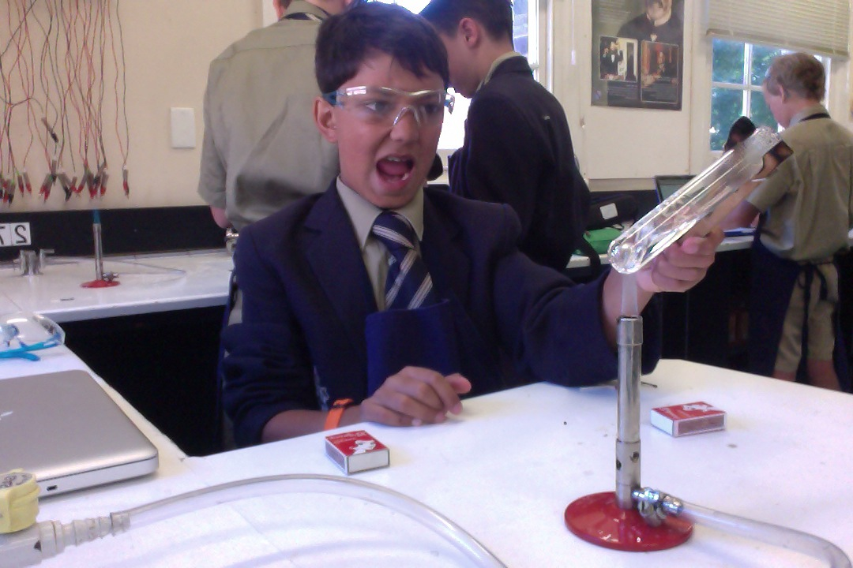
Heat test tubes at an angle.

Slide 11
Never Heat a Closed Container

Slide 12
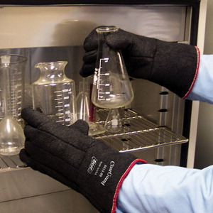
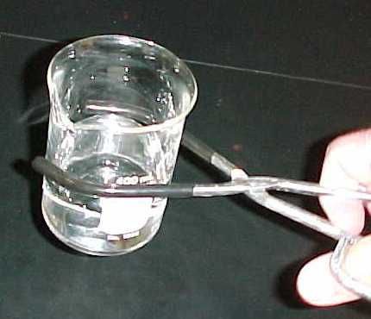
Handle hot glassware with gloves or beaker tongs.

Slide 13
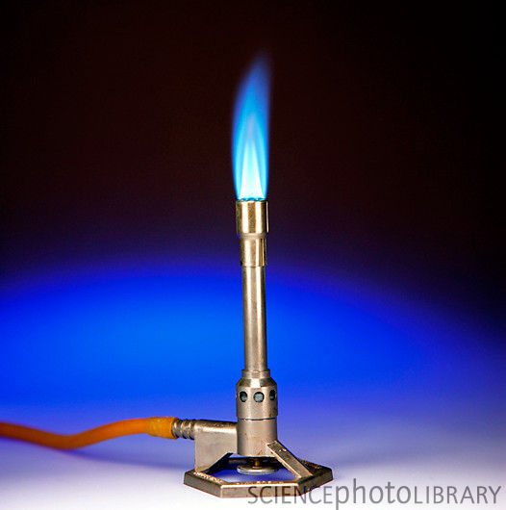
First light the match
THEN
Turn on the gas!

Slide 14
Do not smell any chemicals directly!
Smell chemicals only if your teacher specifically tells you to do so, then use your hand to fan the vapor to your nose.

Slide 15
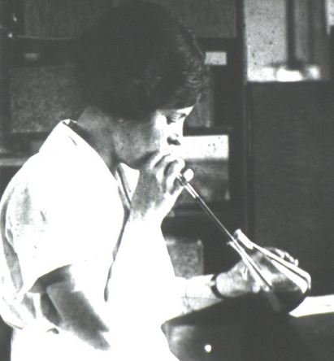
Do not pipet solutions by mouth!
This is why!

Slide 16
Wash your hands with soap and water before leaving.
This rule applies even if you have been wearing gloves!

Slide 17
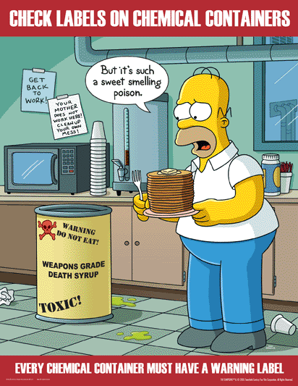
Know the hazards of the materials being used.
Read and reread labels carefully to make sure that you are using the right chemical.
Pay attention to any warnings

Slide 18
Contain Loose Hair
Dangling hair can fall into the Bunsen burner and catch fire or can fall into a chemical solution

Slide 19
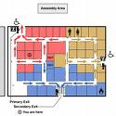
Know the safety equipment
Sinks and Eye wash
Fire blanket
Fire extinguisher
Emergency exit

Slide 20
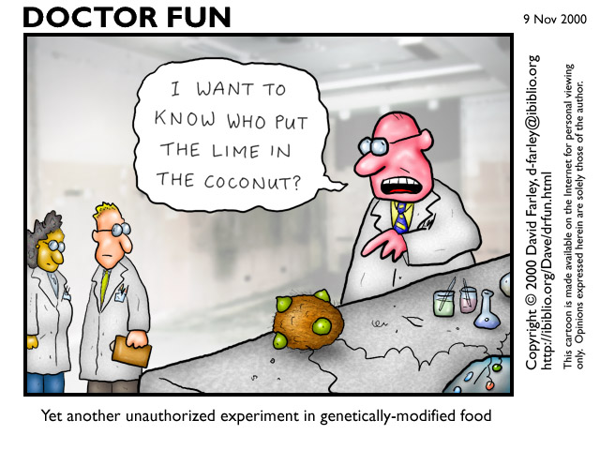
Carry out only the experiments assigned by your teacher

Slide 21
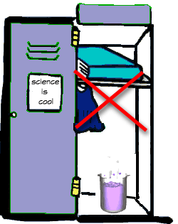
Never remove chemicals from the laboratory

Slide 22
Never work alone in the lab
In case of a problem, you may need another person to prevent injury or even save your life!

Slide 23
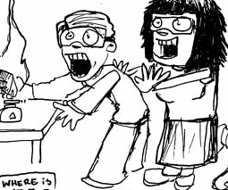
Remember that the lab is a place for serious work!
Careless behavior may endanger yourself and others and will not be tolerated!

Slide 24
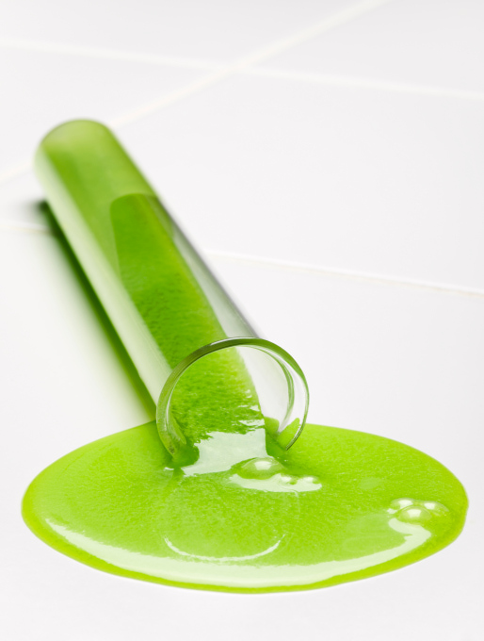
Clean up spills immediately.
If you are uncertain how to clean up a spill or if a large spill occurs, notify your teacher immediately.

Slide 25
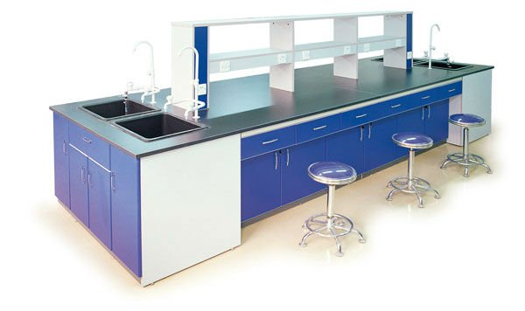
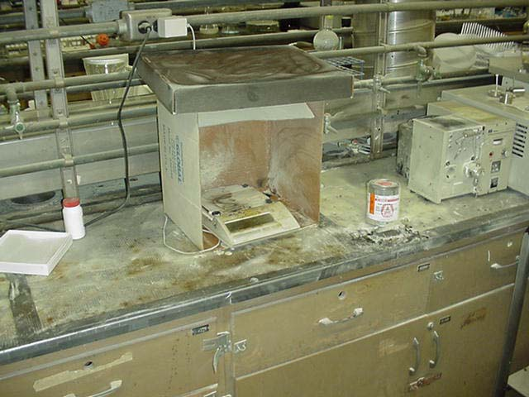
Before leaving the lab:
Return equipment and chemicals to their proper places
Be sure to replace the lids to all containers
Clean up your work area
Like this Not this!

Slide 26
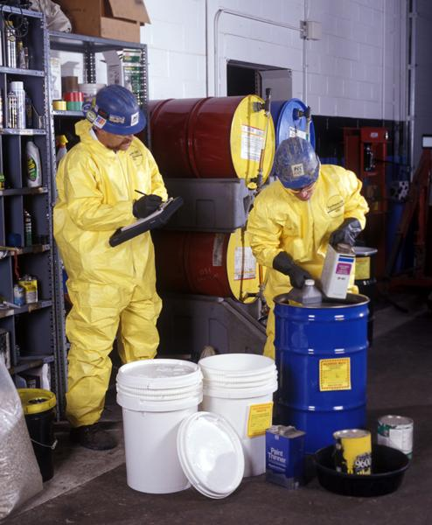
Know how to dispose of waste
Dispose of all waste materials in the correct way.

Slide 27
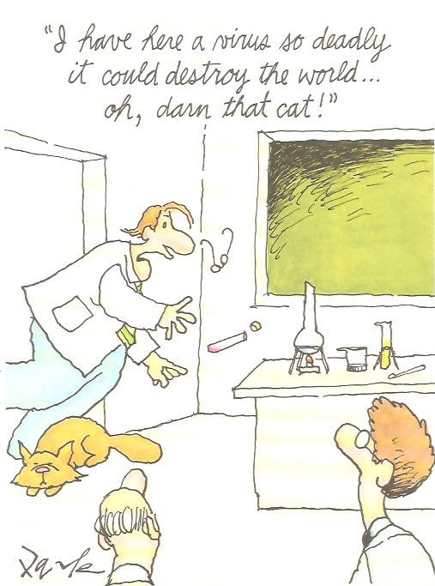
Report any accidents or unsafe conditions immediately!

