Slide 1
Naming and Writing Ionic Formulas

Slide 2
Charges of Representative Elements

Slide 3
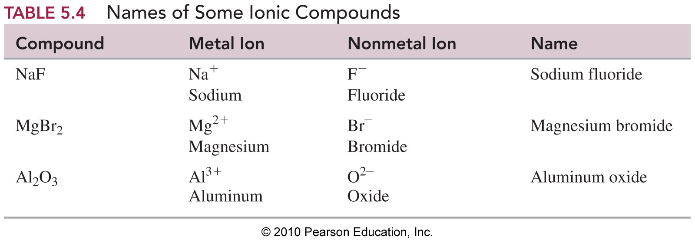
Names of Some Common Ions

Slide 4
Learning Check
Give the names of the following ions:
Ba²⁺ Al³⁺ K⁺
_________ __________ _________
N³⁻ O²⁻ F⁻
_________ __________ _________
P³⁻ S²⁻ Cl⁻
_________ __________ _________

Slide 5
Solution
Ba²⁺ Al³⁺ K⁺
barium aluminum potassium
N³⁻ O²⁻ F⁻
nitride oxide fluoride
P³⁻ S²⁻ Cl⁻
phosphide sulfide chloride

Slide 6
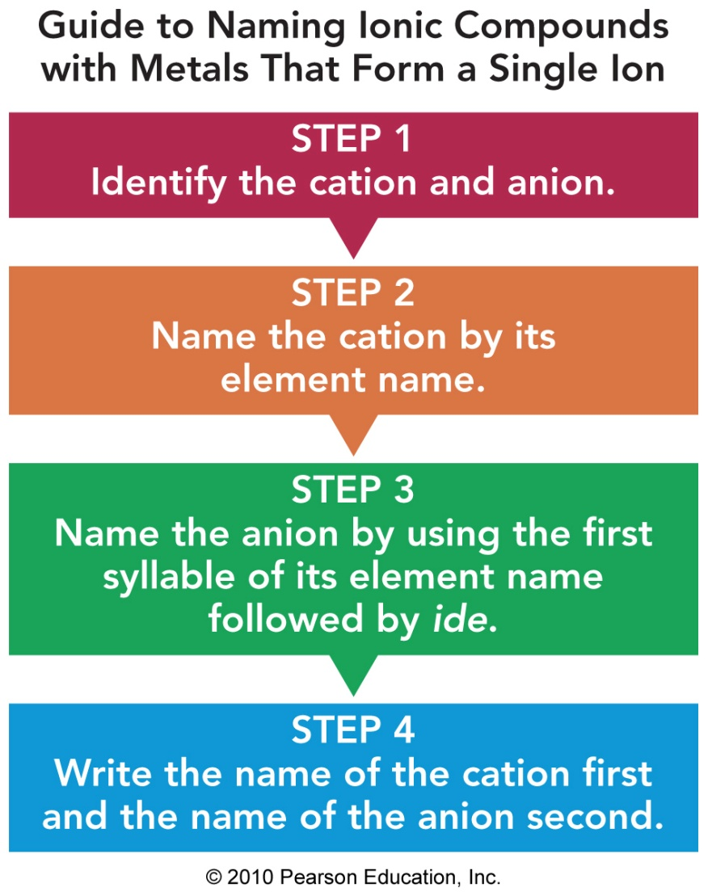
Naming Ionic Compounds with Two Elements
To name a compound
with two elements,
identify the cation and anion
name the cation first, followed by the name of the anion

Slide 7
Examples of Ionic Compounds with Two Elements
Formula Ions Name
Cation Anion
NaCl Na⁺ Cl– sodium chloride
K₂S K⁺ S^{2–} potassium sulfide
MgO Mg²⁺ O^{2–} magnesium oxide
CaI₂ Ca²⁺ I– calcium iodide
Al₂O₃ Al³⁺ S^{2–} aluminum sulfide

Slide 8
Learning Check
Write the names of the following compounds:
1) CaO ___________
2) KBr ___________
3) Al₂O₃ ___________
4) MgCl₂ ___________

Slide 9
Solution
Write the names of the following compounds:
1) CaO calcium oxide
2) KBr potassium bromide
3) Al₂O₃ aluminum oxide
4) MgCl₂ magnesium chloride

Slide 10
Learning Check
Write the formulas and names for compounds of the following ions:
Br– S²⁻ N³⁻
Na⁺
Al³⁺

Slide 11
Solution
Br⁻ S²⁻ N³⁻
Na⁺
Al³⁺
NaBr sodium bromide | Na₂S sodium sulfide | Na₃N sodium nitride
AlBr₃ aluminum bromide | Al₂S₃ aluminum sulfide | AlN aluminum nitride

Slide 12
Transition Metals Form Positive Ions
Most transition metals and Group 4(14) metals,
Form 2 or more positive ions
Zn²⁺, Ag⁺, and Cd²⁺ form only one ion.

Slide 13
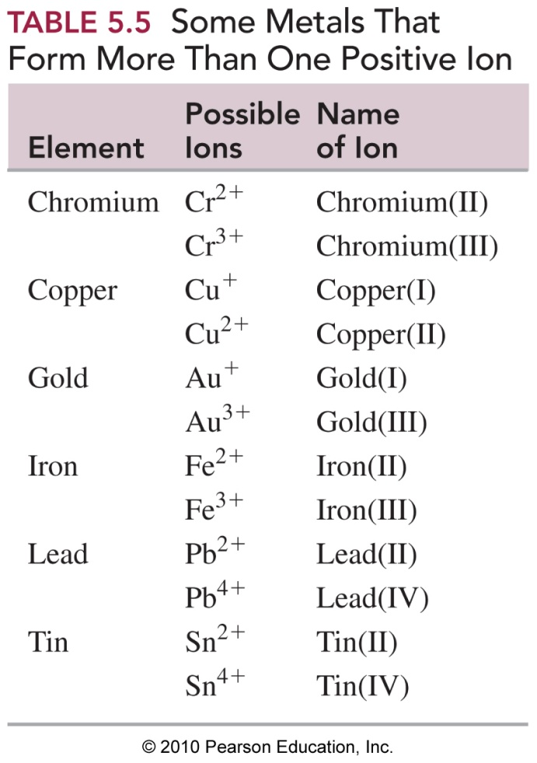
Metals with Variable Charge
The names of transition
metals with two or more
positive ions (cations) use a
Roman numeral after the
name of the metal to identify
ionic charge.

Slide 14
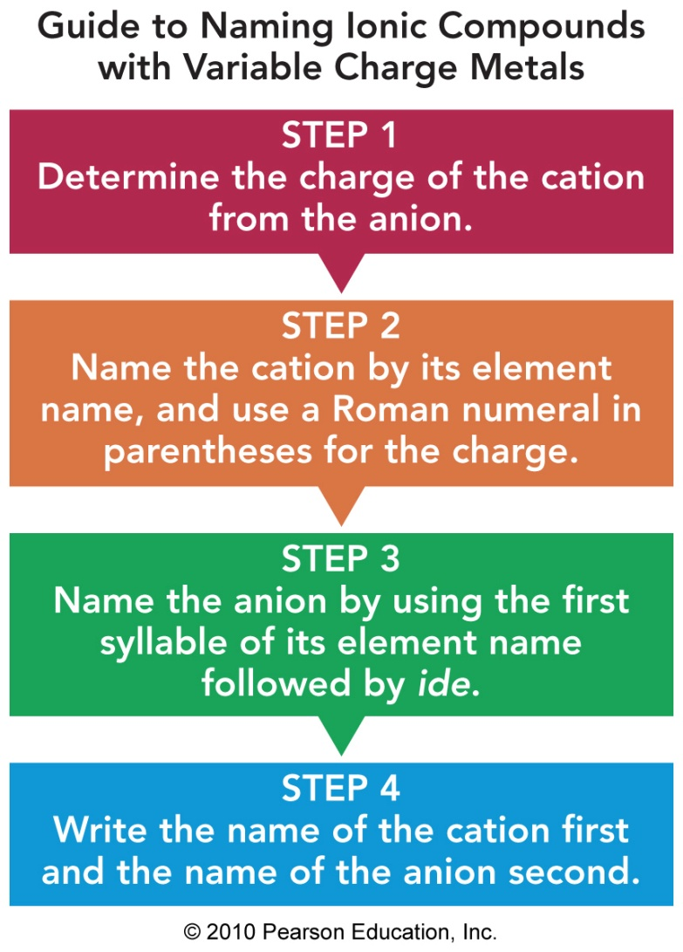
Naming Ionic Compounds with Variable Charge Metals

Slide 15
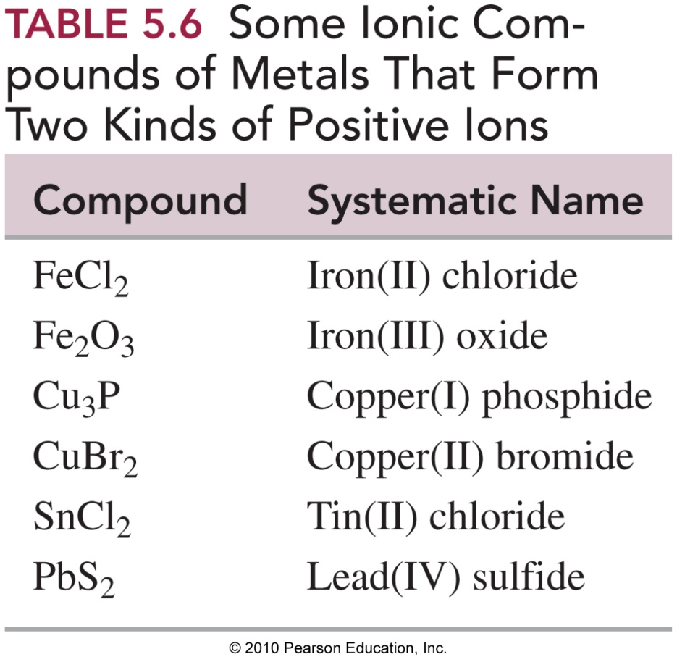
Examples of Names of Compounds with Variable Charge Metals

Slide 16
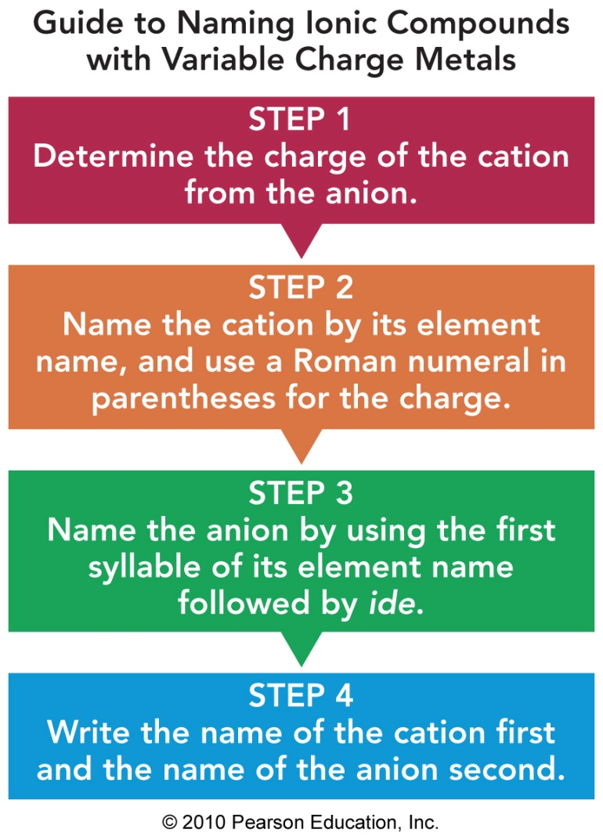
Guide to Naming Ionic Compounds with Variable Charge Metals

Slide 17
Naming FeCl₂
STEP 1 Determine the charge of the cation from the
anion.
Fe ion + 2 Cl– = Fe ion + 2– = 0
Fe ion = 2+ = Fe²⁺
STEP 2 Name the cation by the element name, and use a Roman numeral to show its charge.
Fe²⁺ = iron(II)
STEP 3 Write the anion with an ide ending. chloride
STEP 4 Name the cation first, then the anion.
iron(II) chloride

Slide 18
Naming Cr₂O₃
STEP 1 Determine the charge of cation from the anion. 2Cr ions + 3O^{2–} = 2Cr ions + 3(2–)
= 2Cr ions + 6– = 0
2Cr ions = 6+ Cr ion = 3+ = Cr³⁺
STEP 2 Name the cation by the element name, and use a Roman numeral to show its charge.
Cr³⁺ = chromium(III)
STEP 3 Write the anion with an ide ending. oxide
STEP 4 Name the cation first, then the anion.
chromium (III) oxide

Slide 19
Learning Check
Select the correct name for each.
A. Fe₂S₃
1) iron sulfide
2) iron(II) sulfide
3) iron(III) sulfide
B. CuO
1) copper oxide
2) copper(I) oxide
3) copper(II) oxide

Slide 20
Solution
Select the correct name for each.
A. Fe₂S₃
3) iron(III) sulfide Fe³⁺ S^{2–}
B. CuO
3) copper(II) oxide Cu²⁺ O^{2–}

Slide 21
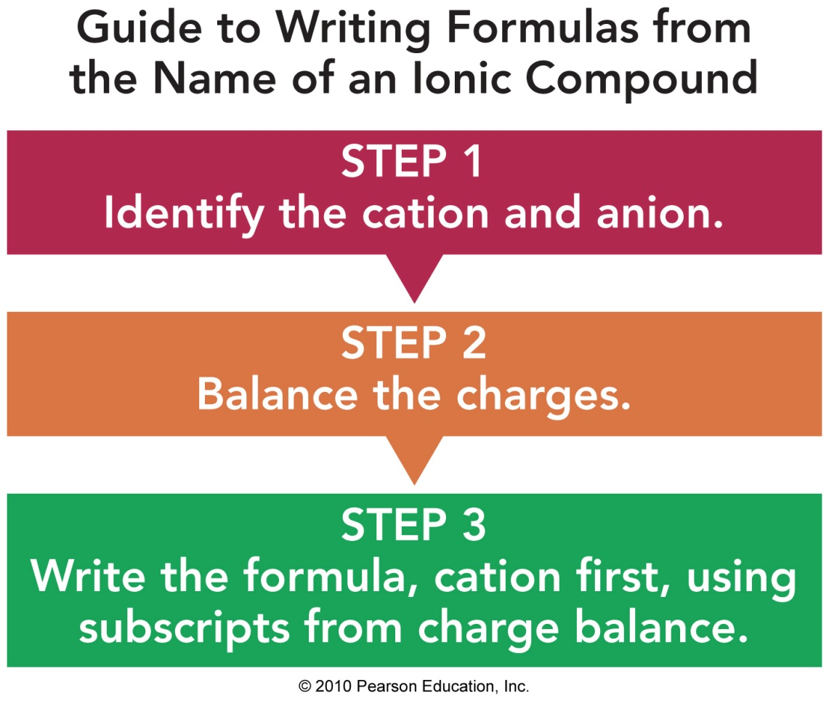
Guide to Writing Formulas from the Name

Slide 22
Writing Formulas
Write a formula for potassium sulfide.
STEP 1 Identify the cation and anion.
potassium = K⁺
sulfide = S²⁻
STEP 2 Balance the charges.
K⁺ S²⁻
K⁺
2(1+) + 1(2–) = 0
STEP 3 Write the cation first.
2K⁺ and 1S²⁻ = K₂S₁ = K₂S

Slide 23
Writing Formulas
Write a formula for iron(III) chloride.
STEP 1 Identify the cation and anion.
iron (III) = Fe³⁺ (III = charge of 3+)
chloride = Cl⁻
STEP 2 Balance the charges.
Fe³⁺ Cl⁻
Cl⁻
Cl⁻
1(3+) + 3(1–) = 0
STEP 3 Write the cation first.
1Fe³⁺ and 3Cl⁻ = FeCl₃

Slide 24
Learning Check
The correct formula for each of the following is:
A. copper(I) nitride
1) CuN 2) CuN₃ 3) Cu₃N
B. lead(IV) oxide
1) PbO₂ 2) PbO 3) Pb₂O₄

Slide 25
Solution
The correct formula for each of the following is:
A. copper(I) nitride
3) Cu₃N 3Cu⁺ + N^{3–} = 3(1+) + (3–) = 0
B. lead(IV) oxide
1) PbO₂ Pb⁴⁺ + 2O^{2–} = (4+) + 2(2–) = 0

