Slide 1
Naming Covalent Compounds
Ch. 16

Slide 2
Covalent Compounds
Covalent bonds form when atoms share their valence electrons.
Covalent compounds are formed from 2 or more nonmetals.

Slide 3
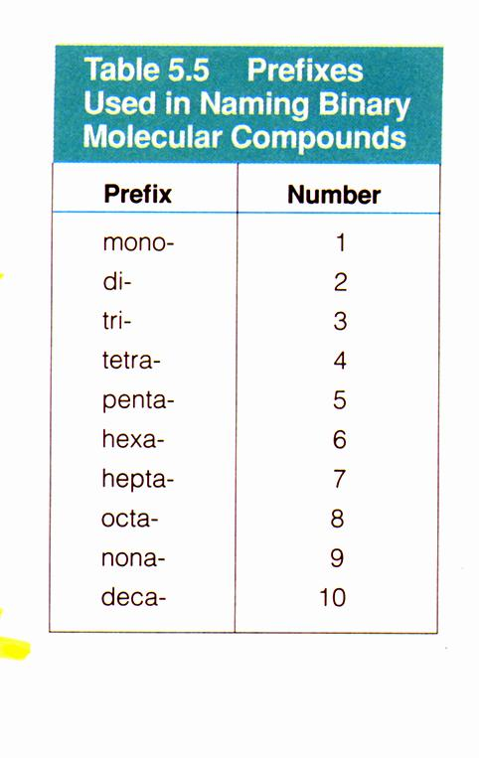
Rules for Naming Covalent Compounds
Prefixes used for Naming Binary Covalent Compounds
1. Prefixes are used to show how many atoms of each element are present in the compound

Slide 4
Rules for Naming Covalent Compounds
2. Second element is written with an –ide ending.
***All binary compounds, both ionic and covalent end in –ide.
3. The vowel at the end of the prefix is dropped when the name of the element begins with the same vowel.
Example: monoxide, not monooxide

Slide 5
Rules for Naming Covalent Compounds
4. Mono is not written if there is just a single atom on the first element in the name.
Example: CO₂
carbon dioxide not monocarbon dioxide
Example: CO
carbon monoxide

Slide 6
Diatomic Molecules
There are 7 nonmetals that exist in nature as diatomic molecules.
Di-Atomic
Formula: Br₂ I₂ N₂ Cl₂ H₂ O₂ F₂
(means 2) atoms
Their names are the same as the names of their monoatomic elements For example, bromine (or molecular bromine to be different)

Slide 7
Problems
Are the following compounds ionic or covalent?
a. H₂O
f. dinitrogen tetraoxide
b. Sodium chloride
g. FeS
c. CuSO₄
h. Cobalt (III) chloride
d. CO
i. H₂S
e. Lithium hydroxide
j. PF₃

Slide 8
Writing Formulas From Names
Write the formulas for the following compounds.
1. carbon monoxide
2. nonacarbon tetrachloride C₉Cl
3. hexabromine dioxide
4. phosphorus trichloride
5. octanitrogen pentafluoride
CO
₄
Br₆O₂
PCl₃
N₈F₅

Slide 9
Naming Binary Compounds (Covalent)
1. SO₂
2. N₂O
3. CCl₄
4. N₂O₅
Sulfur dioxide
Dinitrogen monoxide
Carbon tetrachloride
Dinitrogen pentaoxide
5. N2O4
6. OF₂
Dinitrogen tetraoxide
Oxygen difluoride

