Slide 1
Predict: Is a molecule polar or nonpolar

Slide 2
If the molecule is asymmetric it is polar (electron distribution is uneven)
Lone pairs always make the shape asymmetric. Thus, bent and trigonal pyramidal shapes are always polar

Slide 3
If the shape is symmetric, AND the outer atoms are identical (or have similar electronegativity), then the molecule is nonpolar.
(This is because all bonds are equally polar or nonpolar)
Identical polar bonds, symmetric shape
Identical nonpolar bonds, symmetric shape

Slide 4
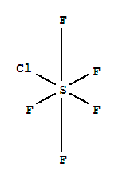
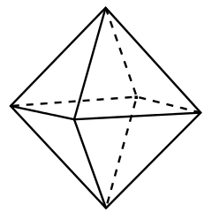
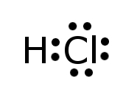
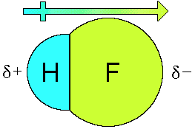
If the shape is symmetric but the molecule has bonds of different polarity, then the molecule is polar.
Nitrosyl chloride
Formaldehyde
Sulfur pentafluoride monochloride
If a diatomic molecule has a polar bond, then it is polar.

