Slide 1
Trends in the Periodic Table and the Bohr Atomic Model

Slide 2
What we have learned so far: Ionization Energy Trends
Groups 1 and 2: IE is the energy required to lose valence electrons.
IE decreases going down the groups.
High IE = low reactivity (electrons are tightly held)
Low IE = high reactivity (electrons are loosely held)
We demonstrated this using a precipitation reaction between metal nitrates and a carbonate.

Slide 3
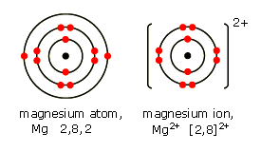
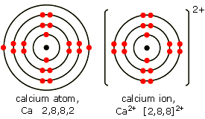
Group 2: Alkaline Earth Metals
Period Element IE (eV)
2 Be (4) 9.3
3 Mg (12) 7.6
4 Ca (20) 6.1
5 Sr (38) 5.7
6 Ba (56) 5.2

Slide 4
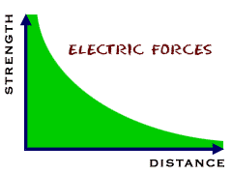
Reason for IE Trend Down Groups
Valence electrons that are farther away from the nucleus are easier to strip away.
Because of their greater distance, they are held less strongly by the protons.

Slide 5
What is a Valence Electron?
This is any electron in the outermost energy level of an atom. All Group 2 elements have two valence electrons. They ionize to (+2).

Slide 6
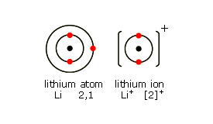
Can you guess how many valence electrons are in group 1 alkali metals?
Period 2 Lithium (3)

Slide 7
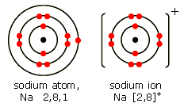
Period 3 Sodium (11)

Slide 8
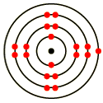
What You Can Tell From the Bohr Atomic Model:
1. What is my atomic number and how do you know?
2. What is my period and how do you know?
3. What is my group and how do you know?
4. What is my charge when I ionize?
(What element am I?)

Slide 9
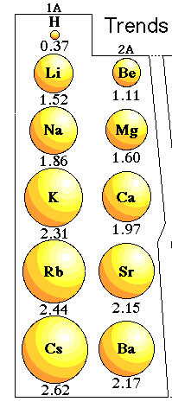
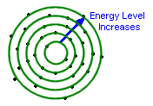
Predict the Group Trend in Atomic Radii
We predict that adding energy levels increases the atomic radius.

Slide 10
What About Electronegativity in a Group?
Electronegativity is the tendency of an atom to attract electrons.
EN is related to the number of protons. Based on that, we predict EN to increase going down a group. Does it?

Slide 11
Explain that!

Slide 12
What about trends along a Period?
Increases or Decreases
Ionization Energy
Electronegativity
Atomic Radius
Explain each!

Slide 13
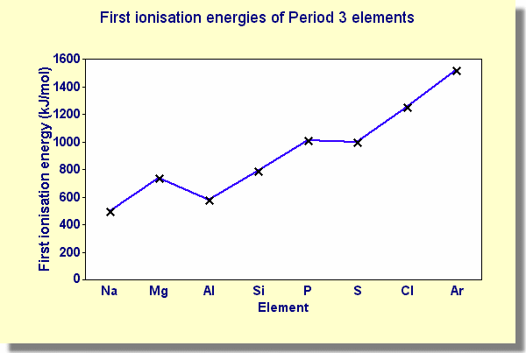
Ionization Energy along a Period
Why?

Slide 14
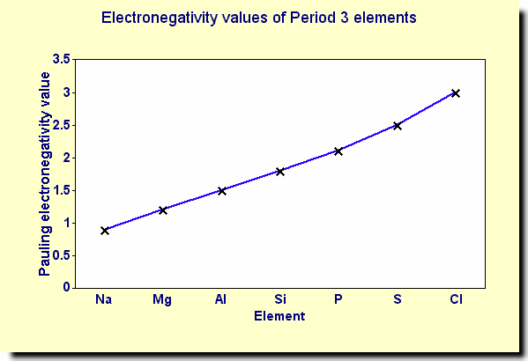
Electronegativity along a Period
Why?

Slide 15
Atomic Radius along a Period
Why?

